Slide 1
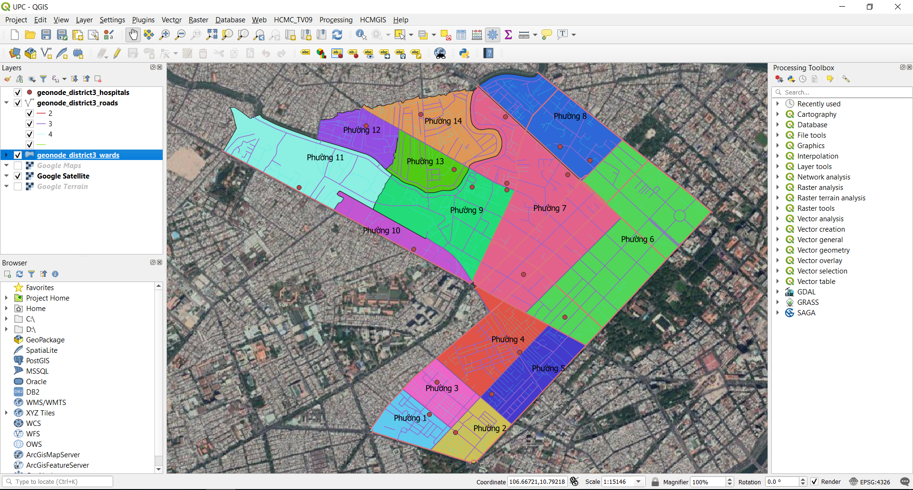
GIS FUNDAMENTALS COURSE

Slide 2
COURSE OUTLINE
Course name: GIS FUNDAMENTALS
Length: 5 days
Goal: Background of GIS, and Mastering QGIS GUI.
Methods: Hands-on, Step by step.
Sample Data: Download from HCMGIS OpenData
References:
https://docs.qgis.org/3.22/en/docs/,
https://docs.qgis.org/3.22/en/docs/training_manual/
https://docs.qgis.org/3.22/en/docs/gentle_gis_introduction/

Slide 3
COURSE OUTLINE
Time | Contents
1st Day | Unit 0: Introduction to GIS, Remote Sensing & GNSS and Applications Unit 1: QGIS Overview How to download and install Useful Terms: Metadata, Encoding, CRS Understanding QGIS Project, how to install and use Plugins Overview of the interface: Menu, Layers list, Browser Panel, Drag and drop, Toolbars, Map Canvas, Status Bar HCMGIS Plugin: Add Basemap, Vietnamese Font Converter, Merge/ Split files,…
2nd Day | Unit 2: Working with Vector Data File and data types Loading Data: Add tool, QGIS Browser, reordering layers Layer Properties: Symbology (Single Symbol, Categorized Symbol), Label Working with Layer Attribute: view/ sort attribute, select feature by expressions, add/ remove fields, calculate field Adding data from AutoCAD, MicroStation Files Export layer, convert geometry type

Slide 4
COURSE OUTLINE
Time | Contents
3rd Day | Unit 3: Coordinate Reference System Useful terms: Geoid, Ellipsoid, Datum, EPSG… Coordinate systems: Geographic Coordinate system, Projected Coordinate system Coordinate Reference System in QGIS: “On the fly” projection, VN-2000 <--> WGS84 CRS transfer Define a new custom projection in AutoCAD for each Provinces in Vietnam
4th Day | Unit 4: Processing Tools Processing tools in Vector menu, Processing Toolbox Attribute join, Spatial Join Check validity, fix geometries Clip, intersection, union

Slide 5
COURSE OUTLINE
Time | Contents
5th Day | Unit 5: Editing Vector Layers and Print Layout Composer Editing Mode, Add new feature, Edit Feature. Compose a print layout Course review
 | Unit 5+: Working with GIS data in AutoCAD

Slide 6
About me
Name: Quach Dong Thang, quachdongthang@gmail.com, 0933908919
Education:
2008: Master of Science in Cartography, Remote Sensing and Geographic Information System (GIS), HCMC University of Technology.
2003: Bachelor of Science in Mathematics and Computer Science , HCMC University of Natural Science.
2023: Bachelor of Art in English Linguistics & Literature, HCMC University of Social Sciences and Humanities
Employment:
2023 – now: GIS Team Lead – Techcraft Ltd.
2021 - 2023: GIS Solutions Team Lead - VNTT Solutions Ltd – A member of Becamex IDC
2008 – 2021: Head of Technology Development Division - Center for Applied GIS of HCM City, DOST.
Duties: Designing and building professional solutions and GIS applications supporting management in urban technical infrastructure, natural resources - environment matters and economic - cultural - social issues.

Slide 7
About me
Participated Projects/ Research Subjects:
Ho Chi Minh City Sewerage Master Plan Update and Adjustment (Package TV-09 - WB Loan), 2018 – 2021.
Building HCMGIS Platforms: GeoPortal, OpenData, GeoSurvey, GeoReference, GeoTag, StoryMaps, PointCloud, 3D, 2018- 2021.
Building Spatial Database Infrastructure for HoChiMinh City, 2016 – 2018.
Updating road network geodatabase to support metro line planning projects of HCM City - funded by Japanese ODA, 2016.
Building WebGIS application for market and shopping center management and planning of HCM City, 2016.
Applying LiDAR technology for updating the road network geodatabase of HCM City, 2014.

Slide 8
Keep Calm and enjoy Learning!

